Slide 1
Reproducible Clinical Data Analysis with R and RStudio
Session 1
Introduction
March 27, 2018

Slide 2
Warm up
Form groups of 2-3 people. Tell each other:
1. Who you are
2. What you’ve done with data in Microsoft Excel
3. What you’d like to be able to do with R/RStudio
Notes:
This is a highly interactive course, and you’ll be doing a lot of the exercises in groups. So I’d like to kick things off by having you form pairs or groups of 3, and tell each other who you are; what experience you have with MS Excel; and what you’d like to do with R/Rstudio. If you don’t know yet, that’s fine! Also – make sure that there’s at least one laptop in each group.

Slide 3
Stephan
Notes:
My turn now - I think most here know me – I’m Stephan. I’m from Germany originally, and came the the US for College. I did my MD/PhD at Upenn and my CP residency, TM fellowship, and now CI fellowship here at the MGH.

Slide 4

Notes:
I’ve been coding in R for 7+ years. I’ve helped to *teach* an R course at MSACL this year and was a speaker at the 2nd annual rstudio conference where I talked about teaching MDs how to code. I’m a certified R/RStudio instructor.

Slide 5
Notes:
And I’ve contributed to several of the open source packages within the R ecosystem. We’ll talk about packages later.

Slide 6
Course Structure
Notes:
Before we get into the material, I want to take a few minutes to explain the structure of this course.

Slide 7
Goals
1. Appreciate Reproducibility in Data Analysis
2. Learn a Practical Way to Analyze Clinical Data Reproducibly
Objectives
1. Define “Reproducibility” and Explain its Importance
2. Learn How to Use R/RStudio to Import Data from Files and Databases; Transform Data; and Visualize Data
3. Create a Reproducible Report About Some Aspect of Quality Improvement
Notes:
Goals
1. Gain an appreciation for the importance of reproducibility in data analysis
2. Learn a practical approach to analyze clinical data in a reproducible fashion
Objectives
By the end of the course, you should:
1. Be able to Define “reproducibility” and explain its importance as it relates to data analysis
2. Gain confidence in your ability to use R/Rstudio to import data from files and databases; and transform and visualize data.
3. Create, with all the necessary technical assistance from me, a reproducible report about some aspect of clinical quality improvement

Slide 8
Introduction | Early: 3/27, 4 PM Late: 3/27, 5:30 PM
Getting Data | Early: 3/28, 4 PM Late: 3/28, 5:30 PM
Exploring Data | Early: 4/3, 4 PM Late: 4/2, 5:30 PM
Reproducible Reports | Early: 4/5, 4 PM Late: 4/5, 5:30 PM
Course Project Presentations | TBA
Notes:
I’ve designed this course so achieve these objectives in the most direct way possible.
The course consists of lectures and a course project, which I’ll describe in a minute.
The lectures follow the structure of a reproducible report – starting by getting the data, and then exploring and visualizing it.
Please take a note of the session #3 where Early and Late sections are NOT on the same day because I couldn’t get the Mallory for the whole time.
Also: although I had everyone sign up for either early or late spot, if you cannot make your signed up spot on a given day, you are totally welcome to come for the other one.

Slide 9
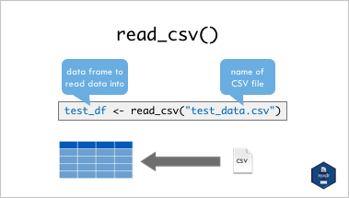
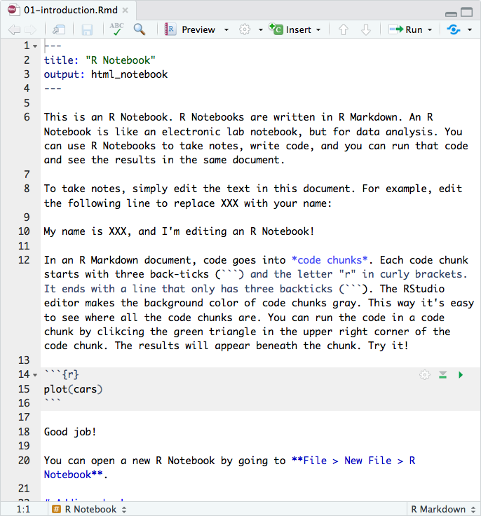
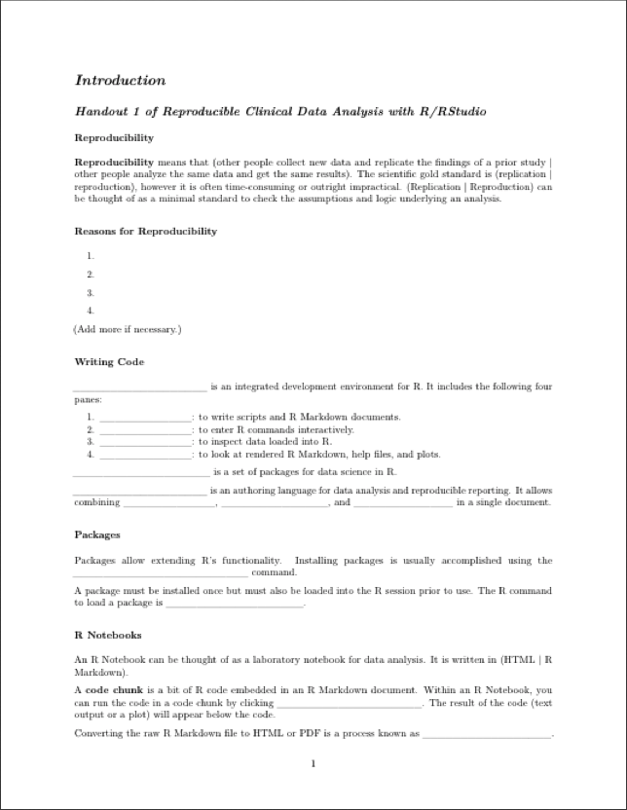
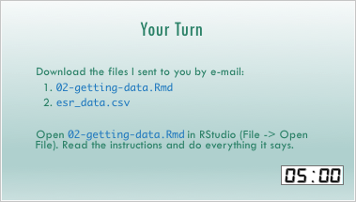
Lectures
Notes:
With only 6 hours of lecture time, it isn’t possible to be comprehensive. After you’ve finished the course you might actually be surprised at how few R commands we covered. But this is by design. I assume that you guys have no prior experience programming. What I’m going to try to do is give you some basic mental models to gain an appreciation of what’s involved in reproducible clinical data analysis, and to become efficient at figuring out what you need to know and where to find the answers to tackle a specific problem you have. I’ll also point out where to look for additional details and further learning. A good way to think about this course is that it’s primer that sets you up to go out and learn R/RStudio for your own work.
So in the lectures, I will present key concepts on slides. There will also be timed interactive exercises to help you consolidate the material just covered.
I will also provide some handouts, which will be fill-in-the-gap to further solidify the concepts and also to serve as a reference for quick review.

Slide 10
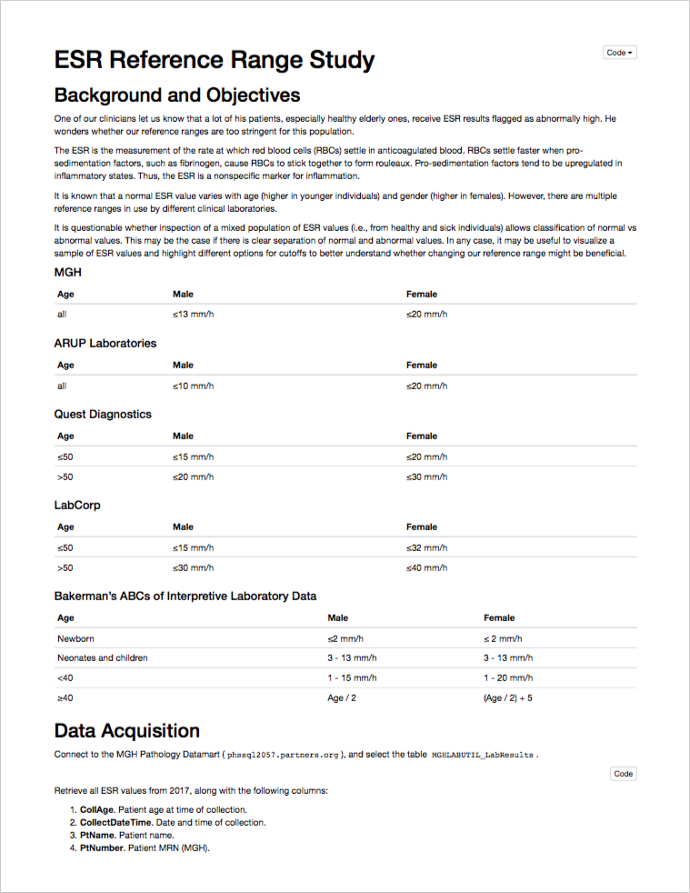
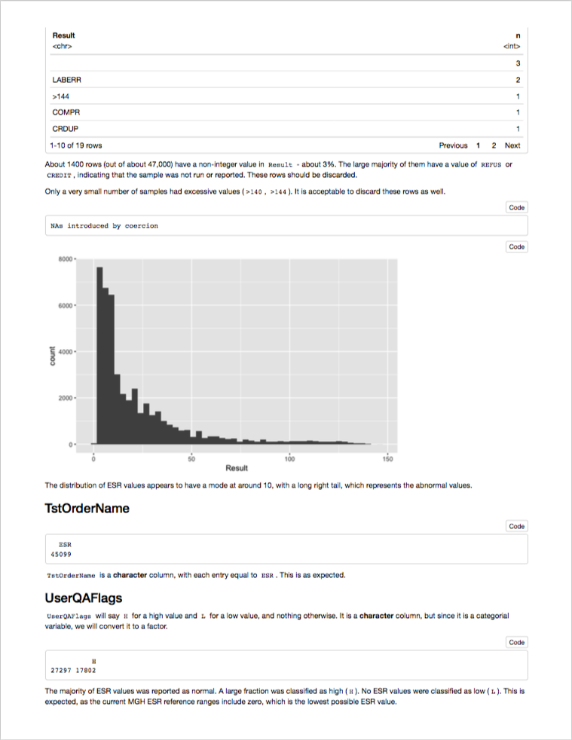
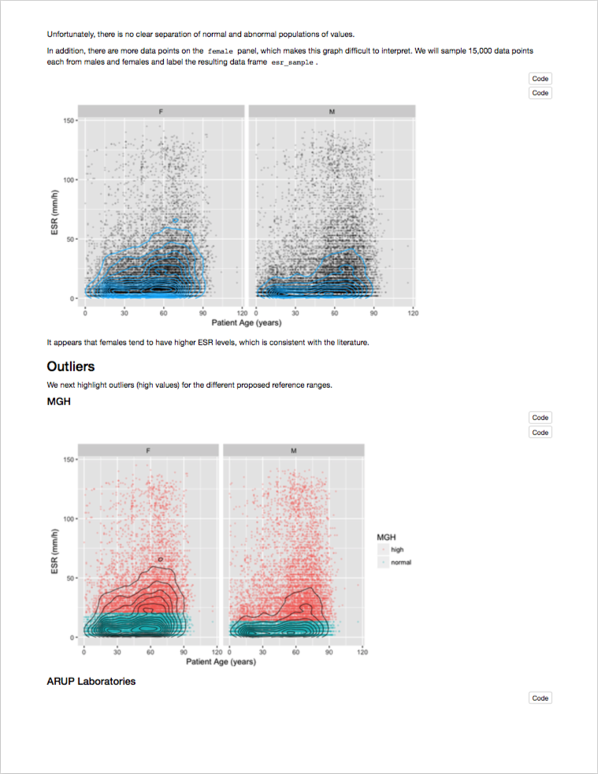
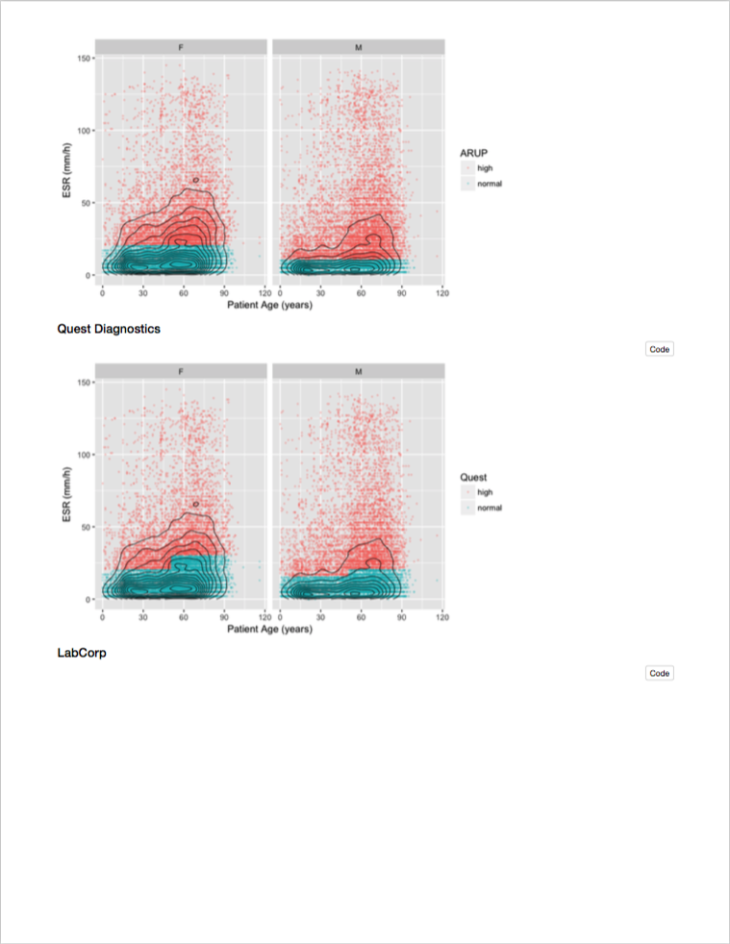
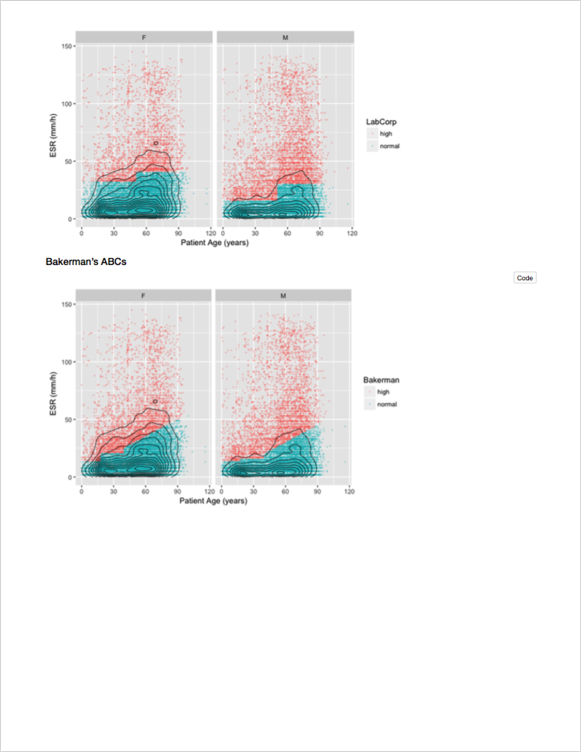
Course Project
Notes:
Together, these in-class activities should get you to a point where you can follow along a reproducible report that’s created in R. However, you won’t learn how to do your own reproducible analysis unless you actually do your own analysis. That’s the purpose of the course project, which is to create report written using a tool called R Markdown that poses a question broadly relating to an aspect of quality of care (research questions are OK also but might require involvement of the IRB). This report will go all the way from importing data from a data file or a clinical database; visualizing the data graphically; and presenting relevant statistical summaries to address the question.
That might sound like a daunting task, especially if you’ve never coded. However, we’ll cover all of the pieces that go into such a report. Then we’re going to pick apart a sample reproducible report, shown on this slide, that looks at a clinical pathology question, and you can use that report as a template. This report examines variability of ESR results over the course of a year.
You can see that there’s a section that defines the question, a section that specifies the data source, and a section that looks at each individual variable.
* Finally, there’s a section labeled “Visualization and Modelin” that attempts to answer the question, what’s the variability of ESR by age and gender, graphically.
So a minimal course project could be simply be examining a different analyte. I could take this report and change it so it looks at CRPs, and that would take me less than 10 minutes to do, because I can recycle all of the code! But you can and should do something you’re interested in. I’ll be there to help you through the process of identifying an appropriate project, identifying the best data source, and writing the analysis and presentation code. Also: if you already have a project in mind or that you’re working on – either research or quality improvement - that would be perfect!
The course project is a mandatory part of the course for the Chem/Micro residents. For all others, it’s optional.
That said, I cannot overstate how much more you will get out of the course if you decide to do a course project. All can feel free to collaborate on a project, including the Chem/Micro residents. Everyone else who intends to do a course project should let me know as soon as possible, but at the latest by session #3 (next Monday or Tuesday).
Course projects will be presented in a separate session in about 4 weeks from now. We’ll schedule a time that works for all presenters.

Slide 11
Reproducibility

Slide 12
Replication vs Reproduction
Replication: other people collect new data
Scientific gold standard
Difficult and time-consuming
Reproduction: other people analyze the same data
Does not by itself validate the analysis …
Has been proposed as a minimal standard
Notes:
It’s probably a good idea to start by definingthe closely related but distinct concepts of Replication and Reproduction.
Replication: other people collect new data and reach the same conclusions
This is the scientific gold standard but is also difficult and time-consuming.
Reproduction: other people analyze the same data and reach the same conclusions
There could still be problems with external validity of the conclusions, however, since it’s theoretically so much easier than going out there and doing an entirely new study, reproducibility has been proposed as a minimal standard to examine the scientific validity of the conclusions of a study.
And as data analysis part of a study becomes more involved, reproducibility of the data analysis becomes more important.

Slide 13
The Duke Cancer Scandal
Chemo sensitivity from microarrays
Errors first, then misconduct
Clinical trials based on flawed models
Papers retracted, lawsuits settled
Notes:
The Duke cancer scandal, perpetrated by Anil Potti and Joseph Nevins, is a case study that has been extensively covered in scientific and lay press.
The investigators tried to use microarray gene expression data of tumor tissue to predict sensitivity to chemotherapeutic agents. That was a highly anticipated technology back in the mid-2000s, and their papers got published in high-profile journals including Nature Medicine, and the NEJM.
What made this case so high-profile in the mainstream media, however, are three factors: 1) Some serious errors were made, but then misconduct occurred when additional data was fabricated to cover up. 2) Flawed predictive models were used to allocate patients to treatment arms in clinical trials. 3) In the end, 11 papers were retracted, and Duke settled 11+ lawsuits.
Although media coverage focused on misconduct, the root cause of patient harm here was that errors that were made during the analysis stage weren’t appreciated in time before clinical trials started. And the main reason these errors remained undetected for such a long time is that there wasn’t a record of the data analysis steps that would have allowed others to examine what the investigators had done.

Slide 14
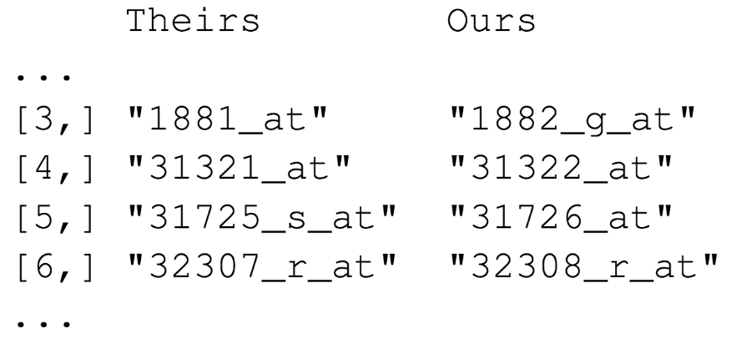

“Common errors are simple, Simple errors are common”
https://youtu.be/tN31vZj0LZY
Notes:
Keith Baggerly – bioinformatician at MD Anderson – is kind of the hero of this saga. I’ll give you an abbreviated version of it here, but I encourage you to follow the link on this slide to hear the full story.
Since the raw data for a Nature Medicine paper in 2006 from this group were public, Baggerly thought that he should be able to reproduce its results by following the methods section, but he consistently got different results.
After trying to resolve these inconsistencies with the authors of the paper, he embarked on an epic effort in Forensic Bioinformatics (the question: what must they have done with the raw data to get the result that they published in the paper)… and documented the errors he found. Here is an example:
These are a few of the hundreds of probe sets – each corresponds to a gene – that the Duke investigators reported to predict sensitivity to 5-FU.
Left (“Theirs”): probe sets as they were published in the paper.
Right (“Ours”): the probe which Keith Baggerly got when he re-did the clustering analysis to get to the list of significantly associated probe sets.
You might appreciate that there is an off-by-one indexing error (frameshift) – root cause: the program the Duke investigators used has a GUI that requires two inputs, first: a list of gene expression values, WITH header row; and second: a list probe sets, in the same order as the first list, but it WITHOUT a header row. So when you use Excel and you cut and paste and include the header row this is what you get.
This is just one of many errors Baggerly and his colleague Kevin Coombes discovered. All of the errors were simple, like label reversal, batch effects, and indexing errors. These errors are common and don’t necessarily indicate that the investigators who make them are incompetent. Peer review of a well-documented analysis actually makes these kinds of errors easy to find and fix. But without documentation, it’s very time consuming.
Optional additional points:
- This is not an isolated incident. 2/18 microarray analyses and 6/53 ”breakthroughs” not reproducible.
Ramifications:
IOM and NCI published guidelines for translation of omics-type tests
International Cmt of Med J Editors (NEJM, JAMA, Annals IM, Lancet, BMJ, and PLOS Medicine) now require sharing of individual patient-level data (of course de-identified)
NIH just updated its grant application guidelines to enhance reproducibility.

Slide 15
Point-and-Click Is Not Reproducible
Interactive tools do not record user actions
Manual documentation is error-prone
Manual analyses cannot be repeated on new data sets or shared with collaborators
Computer code can precisely document each step of the analysis
Notes:
One of the main lessons to take away from the Duke Scandal is that a critical barrier to reproducibility is the tendency of investigators to use graphical user interface “point-and-click” type software.
These interactive tools don’t record user actions. And even if you try to manually document every action you take in MS Excel, it’s usually not complete enough for other investigators to retrace your steps without having to make a lot of assumptions.
An important drawback of manual data analysis is inefficiency. If you want to analyze a new or even slightly different set of data (and most of the time you do a complex analysis, you will!) you’ll have to start over and do everything again.

Slide 16
Your Turn #1
Complete the section “Reproducibility” on Handout 1.
Spend one minute writing down as many reasons as you can think of for why you might want your own data analyses to be reproducible.
Then compare your list with your group mates’.

Slide 17
Why YOU Should Do Data Analysis Reproducibly
“Can we redo the analysis with this month’s data?”
“Why do the data in Table 1 not seem to agree with Figure 2?”
“Why did I decide to omit these six samples?”
Your closest collaborator is You from 6 months ago
(But you don’t answer e-mails)
Notes:
Here’s what I think is the most important reasons to make sure your work is reproducible
…
* …
On a more serious note - if you’re analyzing clinical data and might reasonably change patient management based on your findings, that makes it so much more important that you take steps to assure your analysis is free of errors.
In addition, the NIH just updated its grant application guidelines to enhance reproducibility.

Slide 18
The Tools We’ll Use
Notes:
In this section, I’ll discuss some of the decisions I’ve made around the tools we will use in this course.
One basic design principle I tried to adhere to is that although there are many ways you can do something in R, I will demonstrate only ONE way, the way I believe to be most powerful, intuitive, and suited for the objectives of the course.

Slide 19
“R” Does Not Stand for “Reproducible”… But It Might As Well
RStudio programming environment
Concise human-readable code for data transformation and graphics
Reproducible reporting
Notes:
So, Why R and not, say, python?
R comes with Rstudio, a free-to-use but enterprise-ready integrated programming environment.
R code is concise, and in the style that we’ll be using in this course, also often quite human-readable.
R Markdown, which we’ll talk about more later, makes reproducible report writing easy.
Also: R, Rstudio, and thousands of R packages are free and open-source. They work on Windows, Mac, Linux, and inside a web browser.
R has a huge online community, so finding a solution when you’re stuck is often just a Google search away.
It’s widely used in academia and industry. If there’s a fancy or new statistical method you want to use, there’s probably a well-documented R package for it.

Slide 20
RStudio for Developing Data Analyses
Free and open-source state-of-the-art integrated development environment
Tightly integrated with R Markdown for reproducible reporting
Built-in support for modern machine learning applications including Google CloudML, TensorFlow, and Keras
Notes:
We’ll be using …

Slide 21
Notes:
Here’s what the Rstudio window looks like.
The Editor lets you work with scripts or R Markdown documents; it supports syntax highlighting, code completion, code diagnostics and many more useful features that can make your life easier
The Console is there you go to run R commands, usually if you want to quickly check something or to install a package.
The Environment allows you to look at your data. This gives you back some of the visual benefits of Excel.
The Output pane is where you can view Rendered R Markdown, help documents, or files.

Slide 22
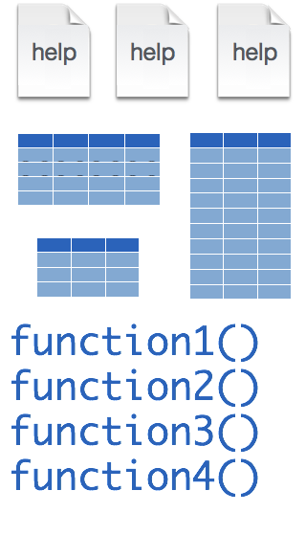
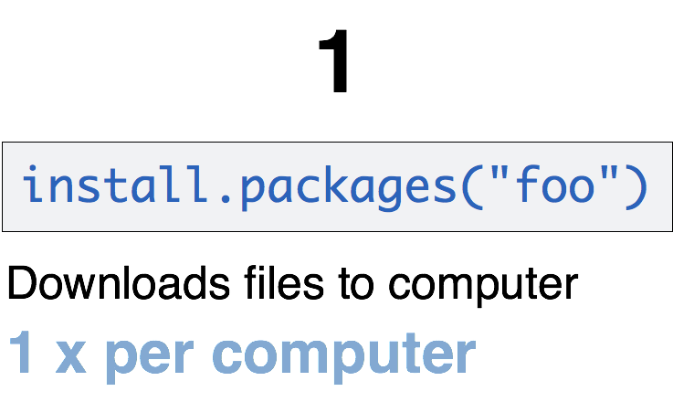
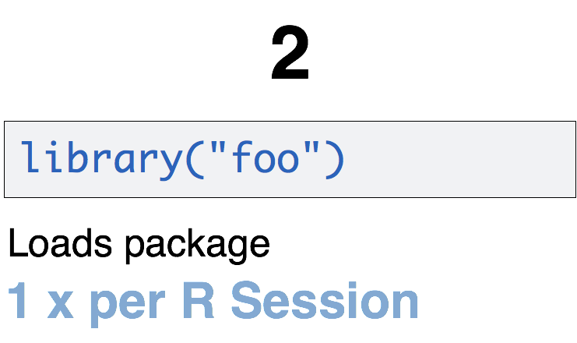
A Word About Packages
foo
CC BY-SA RStudio
Notes:
One of the features that makes R powerful is the fact that it’s easy to extend its functionality with packages.
A package is a bundle file that contains data sets, functions, and help files that document those data sets and functions.
Packages need to be installed explicitly – with the command install.packages. So let’s say you want to install a package named “foo”. You go to the Console and type install.packages(“foo”). If you were able to follow the screencast, you already installed the “tidyverse” package which I’ll talk about more later.
Each package you want to use needs to be installed only once on each computer. However, in order to use the functions or data in the package, you also need to load the package. This is done with the command “library”. So to enable all the functions in the “foo” package, you type library(“foo”). Packages remain loaded until you quit R. So every time you start a new R session you have to load each package that you want to use again.
So these are the first two R commands you’ve learned - install.packages and library.

Slide 23

Your Turn #2
Open RStudio and install the tidyverse package by typing in the Console:
install.packages("tidyverse")
Notes:
So let’s practice - do this now if you haven’t yet installed the tidyverse package.
Make sure you type this exactly as it’s written on the slide. Programming languages are very unforgiving of spelling errors.
And don’t get spooked if there are a lot of lines of red-colored output. Unless it says the word “ERROR” those are just messages.

Slide 24
Tidyverse for “Tidy” Data Analysis
A consistent way to organize data
Human readable, concise, consistent code
Build pipelines from atomic data analysis steps
Notes:
So what’s the Tidyverse I had you install? It’s both a paradigm and a modern set of tools for data analysis in R. It’s quickly becoming the de facto standard for doing data science with R.
The basic tenets of “tidy” data analysis include:
Data should be organized in a consistent, standardized way. Each row is an observation, and each column is a variable. This is a very common way to organize data in a spreadsheet and should sound familiar from Excel.
Programming code that acts on the data should be consistent, concise, and mimic the English language as much as possible.
Each data analysis can be broken down into a series of atomic steps, such as “select this column” or ”arrange the data by the values in that column”. An arbitrarily complex data analysis can be written as a pipeline of atomic steps.

Slide 25
R Markdown for Reproducible Reports
Code remains attached to its documentation and output
Text and code compile into a single HTML or PDF document that can be shared
Reproducible reports can be automated and turned into analytic dashboards
Notes:
R Markdown is a language for reproducible reporting. What this means is that:
Computer code remains attached to English narrative that documents the purpose of the code and details about decisions that were made.
R Markdown documents can be converted into HTML or PDF documents that can be shared with peers.
Since R Markdown documents are computer code, it’s possible to automate them or turn them into analytic dashboards.

Slide 26
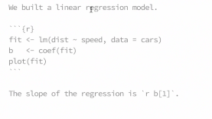
Better to show an example of an actual report, like this?
Notes:
An Rmarkdown document is a simple text file that has a small number of “marks” to add styling. This text document can then be converted into a HTML or PDF document, in a process called “knitting”.
The “marks” (#, *, brackets for link) are designed to be easy to read and remember.
**
Rmarkdown lets you add chunks of R code. This code - don't worry about how it works at this point - generates 100 normally distributed random numbers and assigns them to a variable x. It then calls the summary function on x.
As you can see, in the rendered document the code chunk is placed neatly in a gray box to make it visually distinct from the marked up text.
**
But here’s where it gets exciting: the rendered document also runs the code and shows the result right below the code! This way, a high-quality report is automatically the by-product of a completed analysis.
**
You can also include plots. Here we’re calling the hist function on x, and the rendered document contains a histogram of the values in x.

Slide 27
Notes:
Agile data analysis…
- Every data analysis workflow includes these elements. Someone, usually the project owner imports and cleans up data, and then tries to address an objective by visualizing it, which usually requires some data transformation. Importantly, this cycle repeats because invariably, the results pose additional new questions that need to be addressed in another cycle. Understanding of the data improves with each iteration.
Quality of the analysis depends on total # iterations, as well as the ability of peers to participate.
Speed of the analysis depends on # iterations per unit time. You’ll want to increase speed because time is a limited resource.
RStudio helps with analysis speed because everything is done in one place. This reduces “overhead” from having to jumping to multiple apps that each perform a small part of the analysis. Rstudio also increases access to potential peers because it’s free and cross-platform.
R Markdown is the ideal substrate for iterative data analysis (peer review easy, making changes to even a complex analysis is minimal work)
The Tidyverse allows writing easy to understand computer code, so it enables non-technical peers (domain experts) to participate more fully in the “understand” cycle

Slide 28
Your Turn #3
Open 01-introduction.Rmd.
Read through the R Notebook and do everything it tells you to do.
When you are done, complete the remaining sections of Handout 1.

Slide 29
Notes for next time
Notes:
Sitting in the back corner of the Mallory is awkward
Practice presentation (record)
People were confused about location – let them know in the reminder email
YT #1: Give people more time (5 min) and make it Think-Pair-Share (“be prepared to discuss one of the reasons you came up with”)
YT #2: Say “n” to install from source. OK if it takes a long time
YT #3: Could be longer, there was plenty of time at the end; tell people to download Rmd file, not to open from email
Feedback: not that useful
Could move the R Markdown tutorial here

